Slide 1
Weekly Report - Adidas
April 8, 2021
Jinhang Jiang

Slide 2
Text Analytics Methods Tried
01
TF-IDF
Term frequency–inverse document frequency
Reflects importance of a word to a document
02
Word2vec + TF-IDF
Word embeddings
Vectors of numeric representations of words
Self-trained model
03
GloVe + TF-IDF
Word embeddings
Pre-trained model
1M+ words
04
BERT
Sentence embeddings
State of the art model
10+ pre-trained models from billions of words
05
Sent2vec
Sentence embeddings
Good on small dataset (pre-trained models)
Crashed with large dataset due to RAM limits
06
Doc2vec
Document embeddings
Vectors of numeric representations of docs
Self-trained model

Slide 3
Data
31,145 comments on reddit for 20 celebrities (14+6)
1M total words, 76,472 unique words across the comments

Slide 4
Sent2vec
The demo code showed a very powerful result
It treats each post as a sentence and then generates numeric representations for the sentence
It took huge amount of RAM. Failed running the code on our data with Google Colab (25G RAM / High RAM mode)
Recommend adidas to try this model in the future

Slide 5
BERT
State of the art model for NLP, good for semantic textual similarity(STS)
The original BERT model was trained on the entire English Wikipedia and Book corpus, which sums to 3.3B words
The output shows that it did a good job of marking the distinctions
However, the model gives some crazy results (on the next slide)
If we are ever able to collect enough size of text data, we may train our own BERT model(currently, our dataset contains 1M words)

Slide 6
BERT
Document: documents bully compare irene scandal allegation true lo...
Name: Naeun Son, dtype: object
Similar Documents:
Celebrity: BTS : 0.70624614
Celebrity: BlackPink : 0.69097114
Celebrity: Karlie Kloss : 0.67730826
Celebrity: Solar : 0.6649824
....
Celebrity: Ninjas Hyper : 0.47725105
Celebrity: Seolhyun : 0.3736966
Notes:
Look into the fans activities in other subreddits

Slide 7
GloVe pre-trained model
Another word embedding pre-trained model based on a large amount of tweets (“glove.twitter.27B.100d”)
It contains 1,193,515 key words
Output:
Document: documents bully compare irene scandal allegation true lo...
Name: Naeun Son, dtype: object
Similar Documents:
Celebrity: iZone : 0.9973563636531754
Celebrity: Seolhyun : 0.9967468462513291
...
Celebrity: Adriene Mishler : 0.9467877832902305
Celebrity: Chinae Alexander : 0.9399522006752582

Slide 8
Doc2vec
Generate document embeddings
Treat all the comments for each celebrity as one document
Compute cosine similarity with the embeddings

Slide 9
Doc2vec
Document: documents bully compare irene scandal allegation true lo...
Name: Naeun Son, dtype: object
Similar Documents:
Celebrity: Beyonce : 0.9318335171329294
Celebrity: Zoe Saldana : 0.9301407728667734
Celebrity: GFriend : 0.9262736397358136
Celebrity: Seolhyun : 0.9231553301366306
Celebrity: Kerwin Frost : 0.9180153849693373
...
Celebrity: Ninjas Hyper : 0.903114442673907
Celebrity: Chinae Alexander : 0.9022809969814247
Celebrity: Pharrell Williams : 0.8985577055889704
Celebrity: Karlie Kloss : 0.897284800120694
Celebrity: BTS : 0.8937994592925017
Celebrity: Adriene Mishler : 0.8679664277464215

Slide 10
Word2vec + TF-IDF
Word2vec is a technique for natural language processing., ...
..……
TF-IDF: [ t₁, t₂ , t₃ , t₄ , t₅ , t₆ , t₇ , t₈, …, t_{n}] ^{𝒎*𝐧}
Embeddings
m documents
word embeddings
Vector_size = 𝑣
w₁ | 𝑣1
w₂ | 𝑣2
w₃ | 𝑣3
w₄ | 𝑣4
…. | ….
w_{n} | 𝑣n
s₁
s₂
…
s_{m}
[ ]
^{Shape: (𝒎*𝐧*𝐯)}

Slide 11
Word2vec + TF-IDF
Treat 20 celebrities as 20 documents
m = 20
Top 30% of unique words based on frequency across all the documents n = math.ceil(len(set(words))*30%)
n = 76472*0.3 = 22942
Based on a paper released by Google, the vector size of word2vec embeddings can be determined by the following formula:
embedding_dimensions = math.ceil(number_of_categories**0.25)
v = 1002388**0.25 = 32
4. The shape of the final embeddings is: (20,22942,32)

Slide 12
Word2vec + TF-IDF
This is an unsupervised method, so we do not have a ground truth to evaluate the training process
I used most similar word of a specific word [“kpop”] and log_loss of each epoch as evaluation metrics
Log_loss:
Epoch: 1 Model loss: 1829933.5
Epoch: 2 Model loss: 1797081.75
Epoch: 3 Model loss: 1674911.25
Epoch: 4 Model loss: 1694608.0
…
Epoch: 70 Model loss: 494608.0
model.wv.most_similar("kpop",topn=5)
[('makestar', 0.7831661701202393),
('comeback', 0.7626016139984131),
('rkpop', 0.7273714542388916),
('broadcasting', 0.7255948781967163),
('psycho', 0.7253062129020691)]

Slide 13

Word2vec + TF-IDF
“Makestar”:
Makestar, which will present the projects that stars and fans make together, is a two-way communication window that helps their communication.
It has a lot of korean projects ongoing

Slide 14
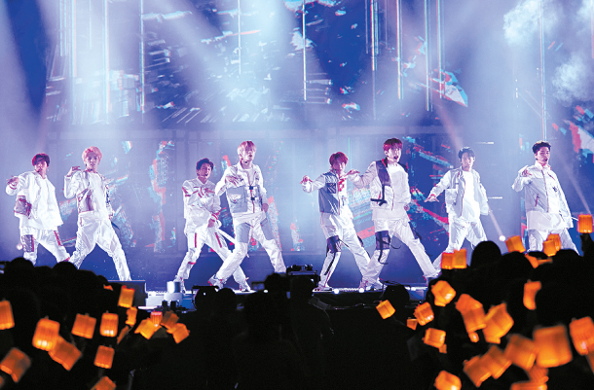
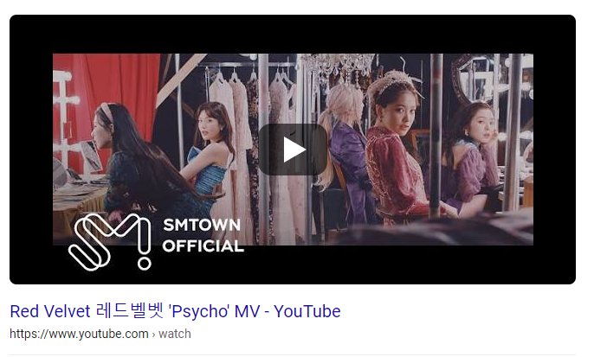
Word2vec + TF-IDF
comeback: A K-pop group coming back with new music.
rkpop: Subreddit for K-pop
broadcasting: Music programs of South Korea (K-pop) are broadcast weekly, with different artists performing on the shows to promote their music.
psycho: A famous song released by Red Velvet (K-pop girl group) in 2019

Slide 15
Word2vec + TF-IDF
most_similar(12,pairwise_similarities2,'Cosine Similarity')
Document: documents bully compare irene scandal allegation true lo...
Name: Naeun Son, dtype: object
Similar Documents:
Celebrity: iZone : 0.9851740700005203
Celebrity: Solar : 0.9845509374922073
Celebrity: BTS : 0.9811527008019006
Celebrity: Seolhyun : 0.9809466263404886
...
Celebrity: Ninjas Hyper : 0.8783205956181265
Celebrity: Pharrell Williams : 0.8765011098185927
Celebrity: Chinae Alexander : 0.8583375081719296
Celebrity: Adriene Mishler : 0.8216310609501457

Slide 16
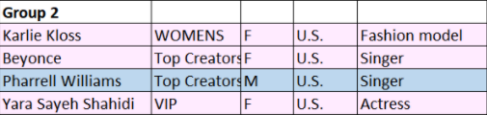
Word2vec + TF-IDF
most_similar(12,pairwise_similarities2,'Cosine Similarity')
Document: documents event year love shit linger like bad perfume ...
Name: Karlie Kloss, dtype: object
Similar Documents:
Celebrity: Yara Shahidi : 0.9512768940445945
Celebrity: BlackPink : 0.9341875248010271
Celebrity: Zoe Saldana : 0.9301733754123521
Celebrity: Beyonce : 0.9271390188740243
...
Celebrity: Ninjas Hyper : 0.8638559838592623
Celebrity: Chinae Alexander : 0.8558076644545808
Celebrity: Kerwin Frost : 0.8284305481584564
Celebrity: Adriene Mishler : 0.7864038143986092

Slide 17
Word2vec + TF-IDF
most_similar(4,pairwise_similarities2,'Cosine Similarity')
Document: documents beyonce new soda pop obnoxious way write note ...
Name: Beyonce, dtype: object
Similar Documents:
Celebrity: Zoe Saldana : 0.9990408205645908
Celebrity: BlackPink : 0.963459862134178
Celebrity: NCT : 0.9568508079720882
Celebrity: Bad Bunny : 0.9538317606323754
...
Celebrity: Ninjas Hyper : 0.912846662345566
Celebrity: Seolhyun : 0.9069799805298574
Celebrity: Chinae Alexander : 0.8525984797518328
Celebrity: Adriene Mishler : 0.8067870901234415

Slide 18
Word2vec + TF-IDF
df_merge[’Beyonce’]
‘beyonce new soda pop obnoxious way write note cringe satire ah yes mafs removed fica chegando notificao os mim desse reditt como faz pra parar good small shade love beyonc unless debuting new music melody work wasnt really interested seeing perform fake hair swift kinda pretentious shes always tryna make compelling statement everyone agrees heard liked beyonc pull card shes nasty energy megan doesnt bother anyone shes kinda autopilot right beyonc jay z heavily affiliated occult dont mind spell get thing go way mean necessarily unrelated always thought acapella know really accomplished ask summer still happened majority decision maker forgotten whats different...’
df_merge[’Zoe Saldana’]
‘mean say exactly bad obnoxious way write note cringe satire ah yes mafs removed fica chegando notificao os mim desse reditt como faz pra parar good small shade love beyonc unless debuting new music melody work wasnt really interested seeing perform fake hair swift kinda pretentious shes always tryna make compelling statement everyone agrees heard liked beyonc pull card shes nasty energy megan doesnt bother anyone shes kinda autopilot right beyonc jay z heavily affiliated occult dont mind spell get thing go way mean necessarily unrelated always thought acapella know really accomplished ask summer still happened majority decision maker forgotten whats different...’

Slide 19
Future work
Compute boilerplate to reduce common information and increase the informativeness and uniqueness of the “documents” for each celebrity.
*In textual analysis, Boilerplate is a combination of words that can be removed from a sentence without significantly changing the original meaning, such as “more than million in” or “at the end of.”
Step 1: find the 4-grams appear across documents (between 30% and 80%)
Step 2: mark the sentence with those 4-grams as 0, otherwise as 1
Step 3: add the the vectors of boilerplate flags to the calculations

Slide 20
Future work
Incorporate the foreign language into our analysis, for example, using google translators, etc.
Collect data periodically to train our own model (like BERT)

Slide 21
What we have done so far
1. Use the APIs to scrape user information, text data, and video data from Reddit and Instagram
2. Social network analysis using node2vec to find clusterings
3. Fanbase similarity analysis using the idea of recommender system
4. Text analysis using word2vec+TF-IDF
5. Similarity analysis using subreddits list

Slide 22
Next step...

